Slide 1
Taking care of god’s temple
Improving Household Nutrition Security and Public Health in CARICOM
Scripture Reading: 1 Corinthians 10:31
01

Slide 2
Introduction
03
Topic: “Taking Care of God’s Temple”
Physical, psychological and spiritual well-being is of critical importance and demand our full attention.
02

Slide 3
Scripture Reading
1 Corinthians 10:31
“³¹So, whether you eat or drink, or whatever you do, do everything for the glory of God.”
03

Slide 4
Remember…
Each of us only has one body that should last us for a lifetime
To take care of our bodies, the temple of God, we must consume healthy foods, maintain a balanced diet, and adopt a healthy lifestyle.
We must focus on preventing illness in our society.
04

Slide 5
Exposition
We must discover God’s way of living and being in order to please and bring glory to God, which is not always the easy or the comfortable choice.
Food is not just for enjoyment or nourishment; it is also a part of our personal walk with God; it is a part of our worship.
05

Slide 6
The 3 Principles
06

Slide 7
Consume foods that are good for the body.
We consume too many things that are not good for us.
There are available, nutritious, cost-effective and reliable sources of food and nutrition that will help to transform our bodies and stay healthy.
Eating healthy is a good way to please God because it is a responsible way to care for the temple of God.
07

Slide 8
2. Consume food in ways that are good for the conscience
Some dietary habits in the Caribbean are harmful to good health and good conscience.
The good conscience of our loved ones and family members are at stake when we selfishly indulge in consumption practices that do not glorify God.
08

Slide 9
We must practice moderation and self-control. Overdoing things is the result of bad judgment and carries disastrous consequences.
Exercising self-control, can minimize the possibility of causing offense to others. We should not only take care of our temple, but we should take care of the temple of others.
The responsible Christian will therefore be sensitive and respectful of the conscience of others, especially those who are weaker than they are, and seek God’s glory in the process.
09

Slide 10
3. Consume food that is good for the health of the human spirit.
We were created in the image and likeness of God. Therefore, there is food for the body and the soul.
Matthew 4:4: “One does not live by bread alone, but by every word that comes from the mouth of God.”
The soul which we possess needs to be nourished by the word of God.
10

Slide 11
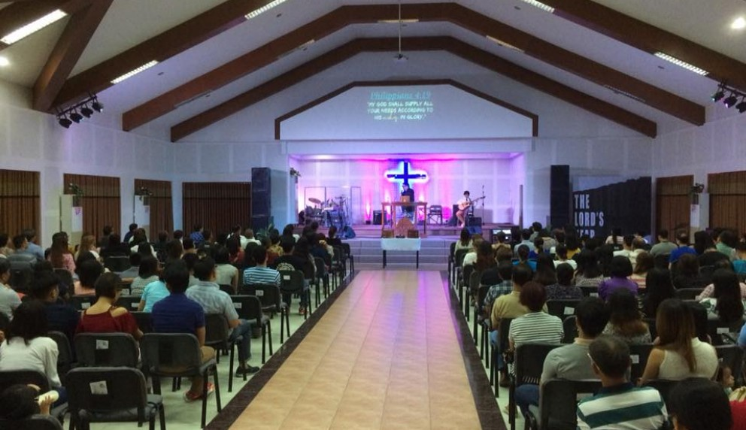
Building spiritual health helps deal with the life in the flesh. We must feast on the “bread of life” which provides us with “abundant life.”
11

Slide 12
Conclusion
The responsible Christian will
Be careful to watch what she or he eats good food in order to ensure good health.
Eat food that is good for the conscience.
Consume food that is good for the soul.
In all these ways, let us take care of the temple of God.
Amen.
12

Slide 13
Our Partners
Improving Household Nutrition Security and Public Health in CARICOM
13

Slide 14
Thank you!
Improving Household Nutrition Security and Public Health in CARICOM
Prof. T. Alafia Samuels
Caribbean Institute for Health Research University of the West Indies, Mona
https://food4changecaribbean.org
@food4changecaribbean

