Slide 1
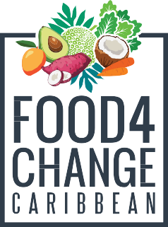
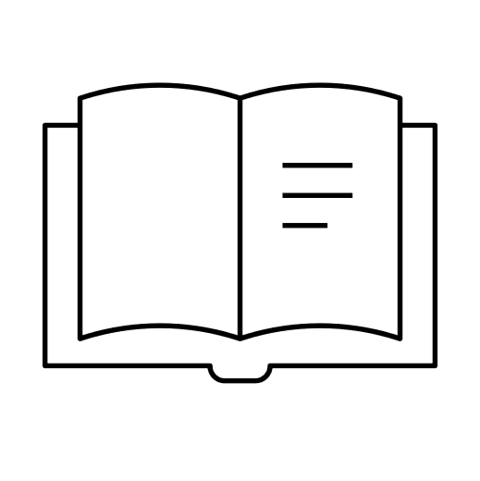
Too much a one thing good fi nothing
Improving Household Nutrition Security and Public Health in CARICOM
Part 2
Scripture Reading: Proverbs 25:16; Proverbs 23:20-21
01

Slide 2
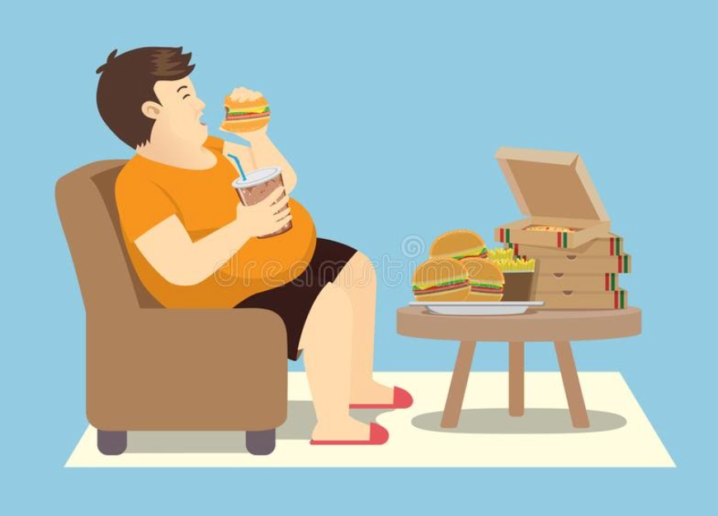
Introduction
03
Title: “Too much A One Thing Good Fi Nothing”
Theme: The Dangers of Overeating
Overeating is a hazard. It is advised to eat in smaller more nutritious portions rather than 3 large meals a day.
02

Slide 3
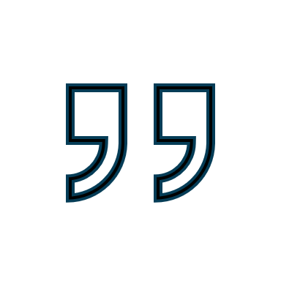
Scripture Reading
Proverbs 25:16
¹⁶ If you find honey, eat just enough—too much of it, and you will vomit..
03

Slide 4
Scripture Reading
Proverbs 23:19-21
¹⁹ Listen, my son, and be wise, and set your heart on the right path: ²⁰ Do not join those who drink too much wine or gorge themselves on meat, ²¹ for drunkards and gluttons become poor, and drowsiness clothes them in rags.
04

Slide 5
Story Time
05

Slide 6
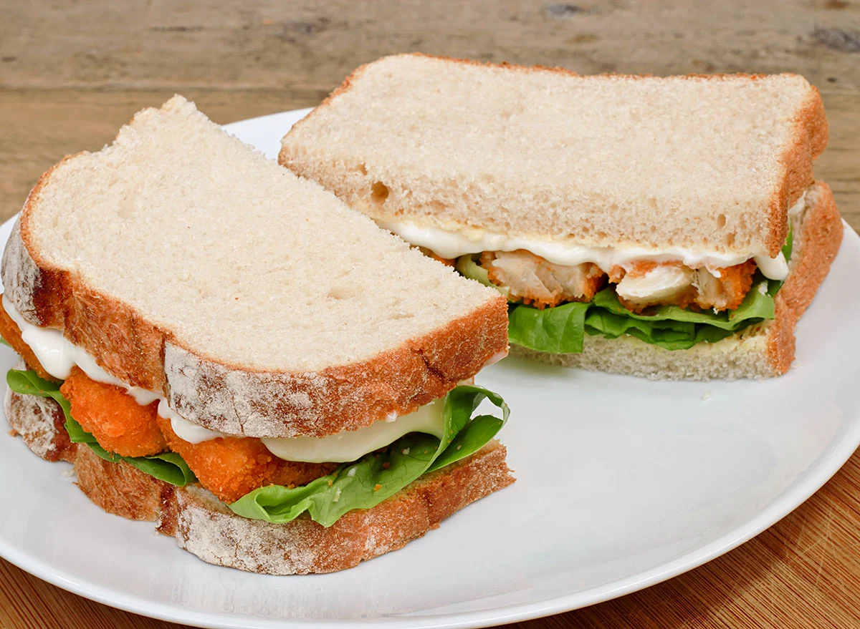
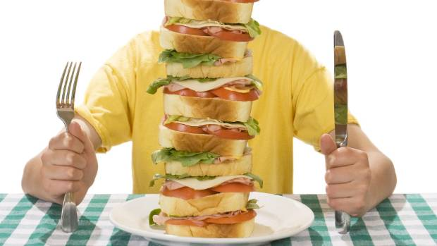
Moral of the Story:
Overeating is not good, it causes food to lose its quality and its positive effect. Modern medicine tells us that eating small portions is the best way to benefit from foods and to ensure our health.
VS.
06

Slide 7
Under-nourishment, Malnutrition and Hunger
There is a problem of distribution, access and costs where food supply is concerned, which has led to hunger and malnutrition.
There is a need for activism to promote food security policies and better terms of trade to ensure that the most vulnerable and poor of the world have access to adequate food.
07

Slide 8
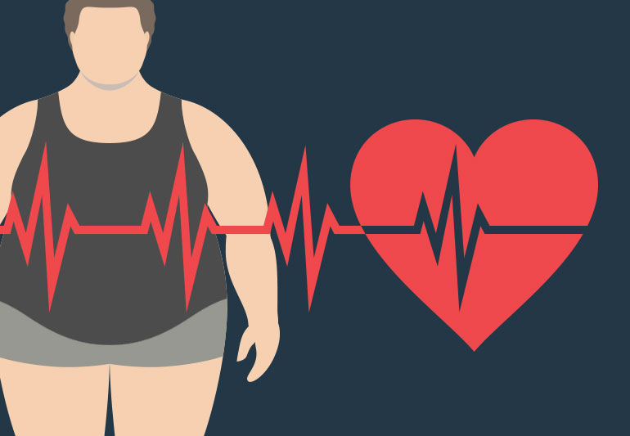
Obesity and Overfeeding
Obesity is the result of the consumption of concentrated fats and salts and of fried foods and concentrated sugars. Sugary drinks and snacks with uncooked salts also contribute to obesity.
Some meals contain things that are gluttony-inducing. We need to ensure that we remain in control of ourselves where our consumption habits and the portions we consume are concerned.
08

Slide 9
Reasons to Manage our Portions and Remain in Control of Ourselves
Demanding Smaller portions can ensure you have food lasting longer and you are around to eat it.
2. After a certain amount of food is eaten, that very food and drink begin to have a counter-productive impact on your body. Even good things can become bad if they are overdone.
09

Slide 10
Reasons to Manage our Portions and Remain in Control of Ourselves cont’d
3. Having a meal is a time to share with and think about your loved ones. Gluttony and overfeeding defeat the purpose of a meal because you are being pre-occupied with only yourself and your desires.
4. Loss of control which results in gluttony and drunkenness can cause deterioration of self-management and one’s sense of self. It is important to have control, even with the foods that you love.
10

Slide 11
Conclusion
Food is best enjoyed in small portions. Your body will do its best to process small portions; it will nourish you and not harm you. If you consume less, you are leaving some to share with others.
Manage your portions, it can save your life.
Amen.
11

Slide 12
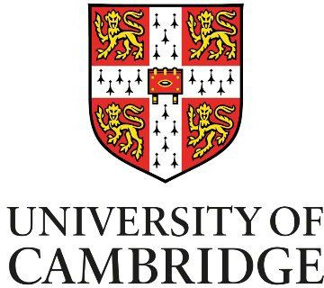
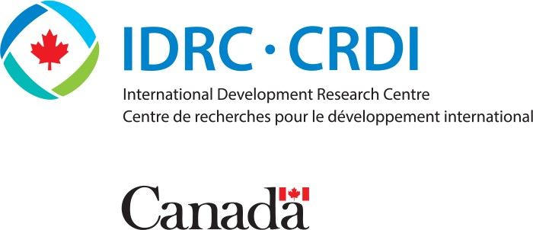
Our Partners
Improving Household Nutrition Security and Public Health in CARICOM
12

Slide 13
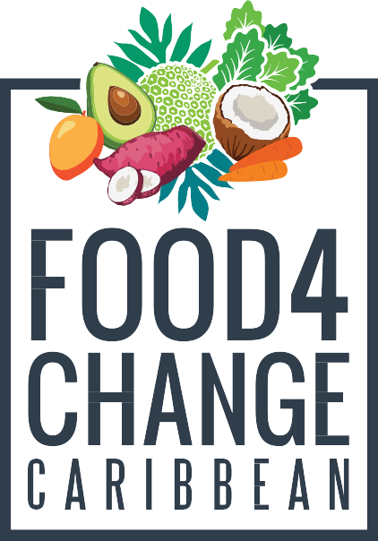
Thank you!
Improving Household Nutrition Security and Public Health in CARICOM
Prof. T. Alafia Samuels
Caribbean Institute for Health Research University of the West Indies, Mona
https://food4changecaribbean.org
@food4changecaribbean

