Slide 1
FOODS ARE GIFTS FROM GOD
Improving Household Nutrition Security and Public Health in CARICOM
Scripture Reading: Genesis 1:29-31
01

Slide 2
Introduction
03
Topic: “Foods are Gifts from God”
God has created human beings in His very own image and will provide daily Bread for His children. He is a provider to all living things.
02

Slide 3
Scripture Reading
Genesis 1:29-31
29 “Then God said, “I give you every seed-bearing plant on the face of the whole earth and every tree that has fruit with seed in it. They will be yours for food.
30 And to all the beast of the earth and all the birds in the sky and all the creatures that move along the ground everything that has the breath of life in it. I give every green plant for food”. And it was so
31 God saw all that He had made, and it was very good. And there was evening and morning the sixth day.
.
03

Slide 4
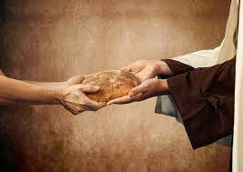
God gave Adam and Eve specific instructions and were invited to join God in working in the Garden of Eden.
He made it clear that he was providing for all living things. He is a provider of all good things.
04

Slide 5
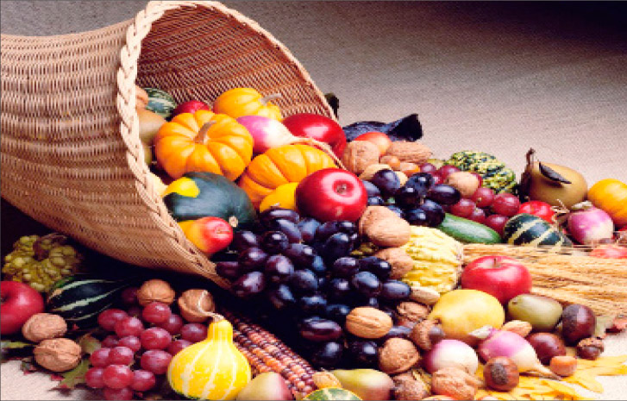
Harvest Hymn:
We plough the fields and scatter the good seed on the land.
But they are fed and water and By God’s Almighty hand.
He sends the snow in winter the warmth to swell the grains.
The breezes and the sunshine the soft refreshing rain.
Refrain
All good gifts around us are sent from heaven above.
Then thank the Lord, O thank the Lord for all His love” (Rutter).
05

Slide 6
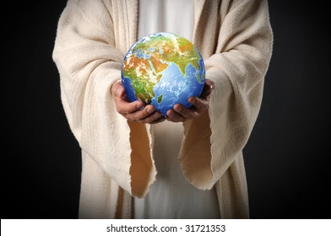
What can we learn?
God is our source of supply for our bodily needs. He provides for us in ways we will never fully understand.
06

Slide 7
What can we learn?
2. Our bodies are “Temples of the living God”. Therefore, everything we do with our bodies are directed to giving glory to God. Humans and animals have a basic need for food.
Remember Verse 30:
And to all the beast of the earth and all the birds in the sky and all the creatures that move along the ground everything that has the breath of life in it I give every green plant for food”. And it was so.
07

Slide 8
What can we be Thankful for?
Remember Genesis 1:27:
“So God created man in his own image. In the image of God, he created him; male and female, He, God created them”
God made us in his own image and we must honour that by paying attention to what we eat and how we treat our bodies.
He ensured that His provision of food would last us forever and we must accept these gifts from God with thanksgiving, praise and adoration.
08

Slide 9
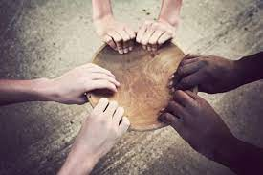
What can we Commit to?
We are made out of the earth and it is that same earth which must sustain us.
OUR MAINTENANCE COME FROM THE EARTH
The Lord has provided enough food to sustain all of humanity forever. However, every day we see people in poverty starving.
09

Slide 10
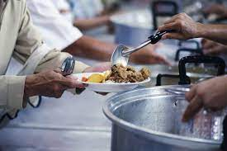
“God saw all that He had made, and it was good. And there was evening and there was morning… the sixth day (Gen. 1:31).
God made sure that foods which help us GO, GLOW and GROW are available for all living things. We must never ever underestimate the love which God has for us in that he provided a complete dietary plan for us to be healthy and strong humans here on earth.
10

Slide 11
To Think About:
We must ensure that we treat our bodies well by eating the right kinds of food
We must ensure that we become our brothers’ and sisters’ keepers and share what we have.
We must ensure that we are obedient to the commandments of the Lord as we develop good eating habits.
We must realize that food sustains our bodies and our bodies belong to God.
11

Slide 12
Hymn
“In this our bounteous island God smiles his sweetest smile;
from ferny dell and covert wild flowers our eyes beguile;
among the leafy branches. The ripened mangoes sway,
and green pimento berries make fragrant God’s bright day.
Refrain:
Praise him, ye bright people,
With harvest hymn of joy;
O give to God a hymn of praise,
And love without alloy.
(Eva R. Nicholson Caribbean Moravian Praise)
12

Slide 13
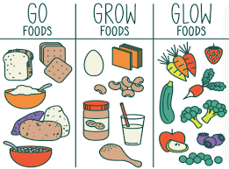
Conclusion
- Ensure that your diets are in line with the commands of the Almighty Provider of all our foods.
- Remember FOODS ARE GIFTS FROM GOD. So ensure that we are eating the Triple G’s foods, that is, GLOW , GO and GROW Foods.
13

Slide 14
Our Partners
Improving Household Nutrition Security and Public Health in CARICOM
14

Slide 15
Thank you!
Improving Household Nutrition Security and Public Health in CARICOM
Prof. T. Alafia Samuels
Caribbean Institute for Health Research University of the West Indies, Mona
https://food4changecaribbean.org
@food4changecaribbean

