Slide 1
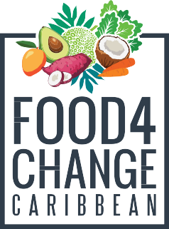
Let’s talk about… SUGAR
Improving Household Nutrition Security and Public Health in CARICOM

Slide 2
Different types and forms of sugar

Slide 3
HIDDEN SUGARS IN LABELS & PRODUCTS
DIFFERENT NAMES FOR SUGAR:
Lactose - Brown rice, Syrup; Molasses Dextrose - Cane sugar; Corn sweetener
Fructose - Glucose; Maltose; Organic raw sugar; maltodextrin etc..

Slide 4
HIDDEN SUGARS IN LABELS & PRODUCTS
PROCESSED FOODS WITH SUGAR:
Barbecue sauce; bacon and sausages (some); bread; canned meats; cereals; crackers; gravy; flavored coffee; creamers; fruit juice; ketchup; mustard; pancake mix; pretzels; salad dressing; soups; soy sauce; wine etc.

Slide 5
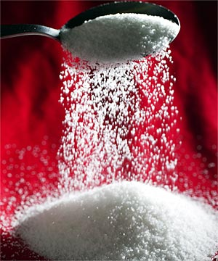
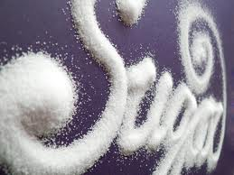
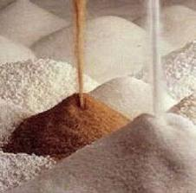
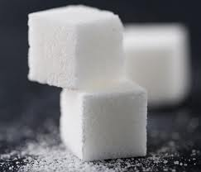
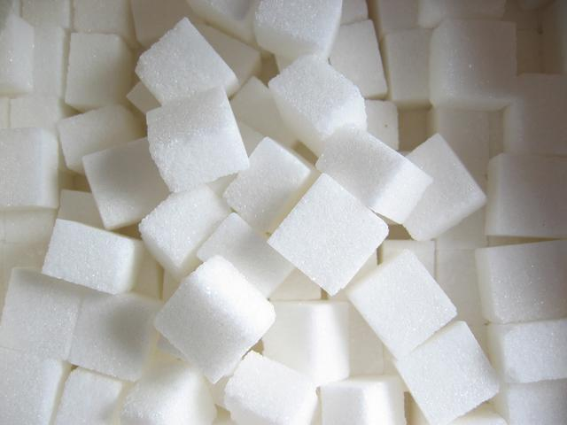
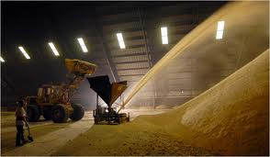
THE SUGAR WE SEE

Slide 6
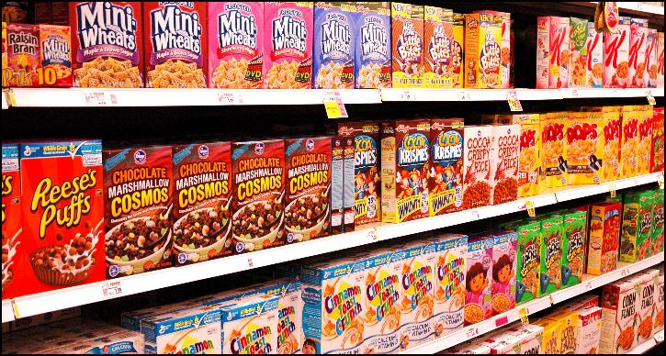
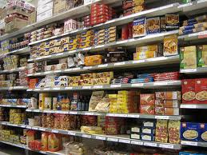
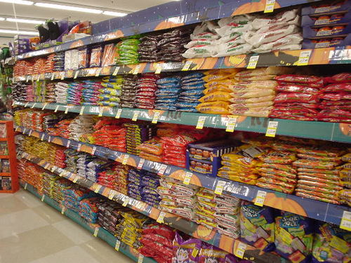
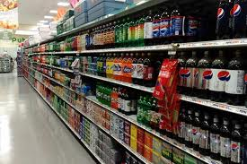
BUT WE’RE SURROUNDED BY SUGAR! IT’S EVERYWHERE! AND IT’S SO TASTY!

Slide 7
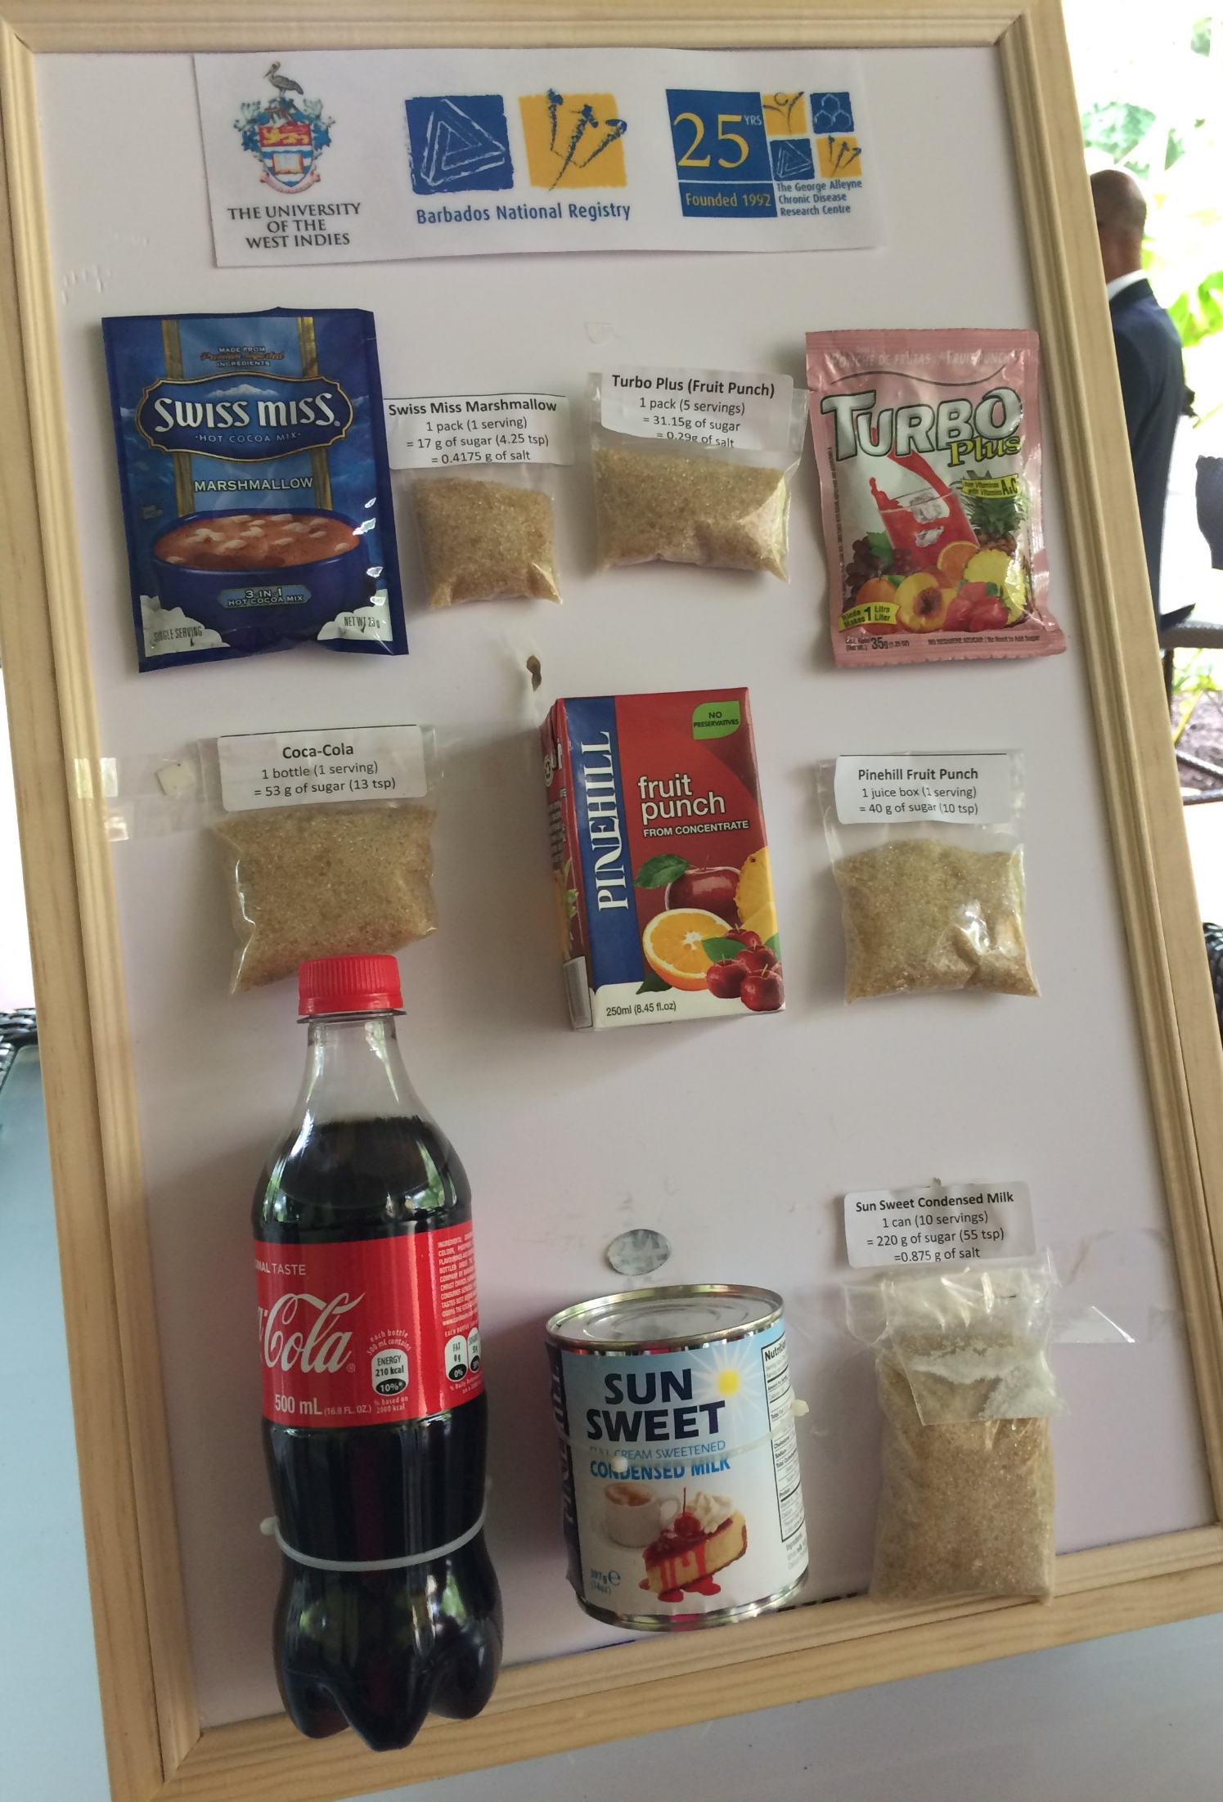
SUGAR IN THE FOOD WE EAT

Slide 8
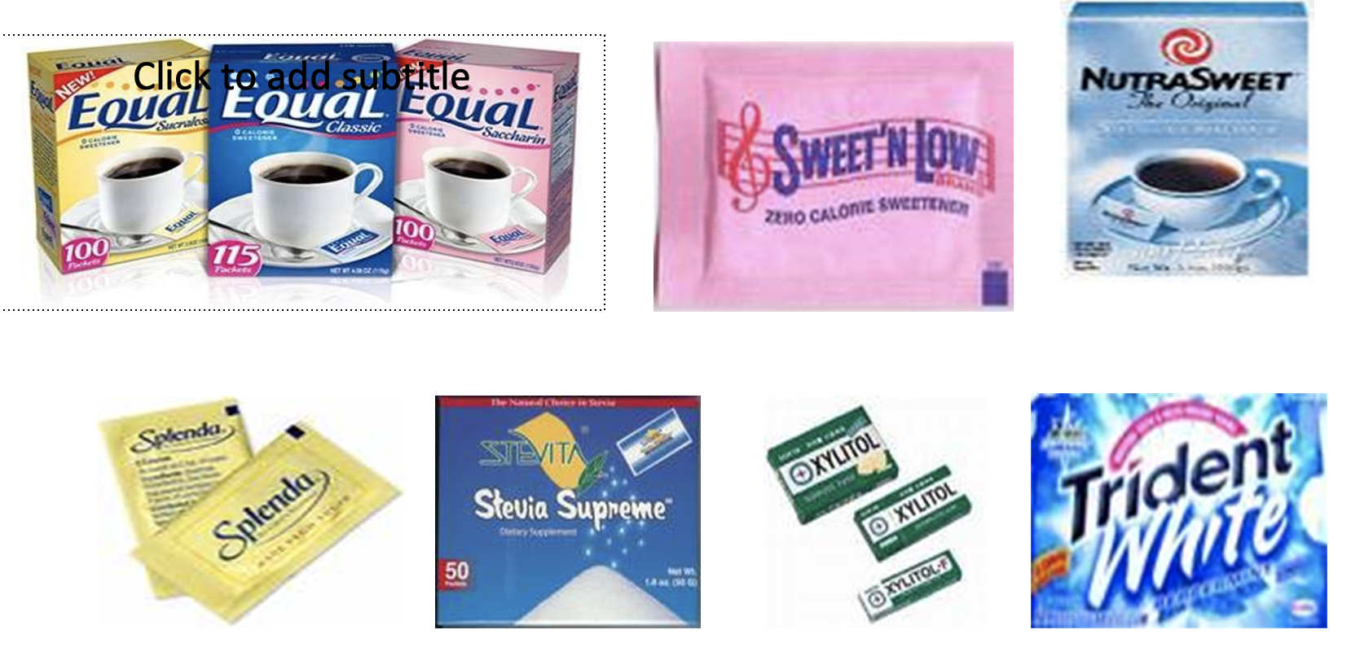
BEWARE of Artificial Sweeteners
.
Interferes with hunger messages in your gut. Makes it prepare for high calorie food
When you taste sweet foods (even with no calories) your body releases insulin which lowers blood sugar and increase cravings for more sweets.

Slide 9
Sugar Sweetened Beverages (SSBs)

Slide 10
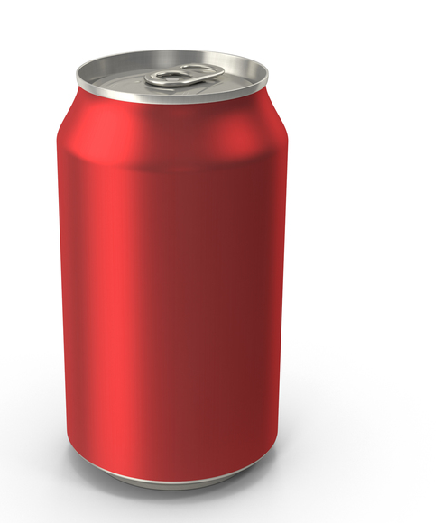
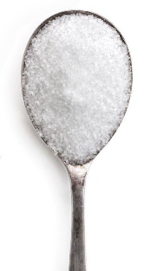
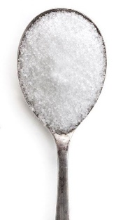
The cost of a daily sugary drink
Drinking one 12 oz. (355 mL) soft drink every day for a year :
≈150 calories × 365 days = 54,750 calories per year = 15 pounds of fat per year
12 oz.
355 mL
To avoid weight gain:
To burn off the calories from ONE 12 oz. sugary drink, the average person would have to walk 1.5 miles
One 12-oz can soda contains over 9 tsp sugar

Slide 11
Added Sugar In Drinks
Compared to solids, calories from drinks do not satisfy hunger since there is no feeling of fullness = Wasted Calories
Sugar in SSBs contain no nutrients = Empty Calories
Fructose is of major concern as it is rapidly absorbed and goes to the brain.
Sugar in SSBs are absorbed extremely rapidly causing a big increase in blood sugar and in insulin = Dangerous Calories

Slide 12
Obesity & Sugar Sweetened Beverages (SSBs)
SSBs are a major cause of obesity, diabetes and heart disease in both adults and children
Sugar sweetened beverages can lead to weight gain

Slide 13
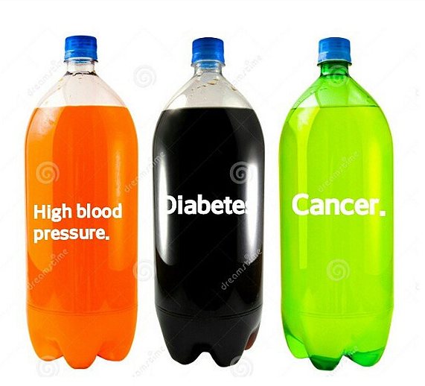
Health Impacts From SSBs
SSBs can lead to:
Overweight & obesity
Diabetes
One SSB per day increases the risk of diabetes by 18%
High blood pressure
Heart disease
Two SSB per day doubles the risk of heart disease
Dental cavities

Slide 14
Childhood Obesity in Jamaica
In 7 years (2010 to 2017), among children 13 – 15 years:
Obesity among boys DOUBLED, from 1 out of 20, to 1 out of 10
Obesity in girls increased by half, from 1 out of 15 to 1 out of 10
If this trend continues, by 2025:
1 out of 7 boys, and 1 out of 8 girls will be obese, and at risk for
High blood pressure
Diabetes
Joint problems

Slide 15
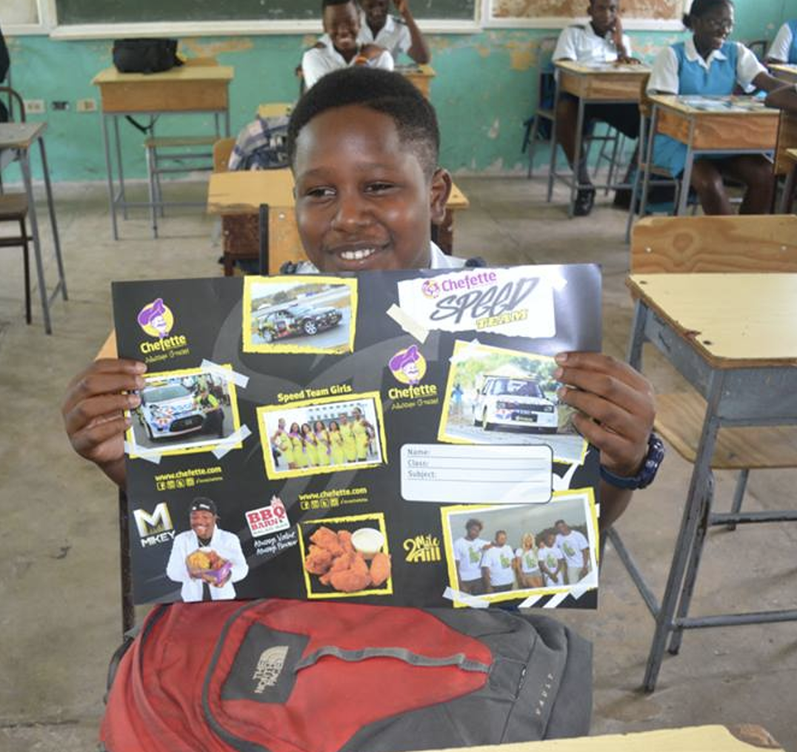
How Did We Get Here?
Producers and marketers of unhealthy foods target children through…
Advertising and Marketing

Slide 16
Creating Brand Preference in Children Dr Emma Boyland, University of Liverpool 6 months: Forming mental images of corporate logos and mascots. 2 years: Children have beliefs about specific brands. 3 years: Already making specific requests for brand name products. Can identify brand names & logos especially with cartoon characters.
Advertising & Marketing -

Slide 17
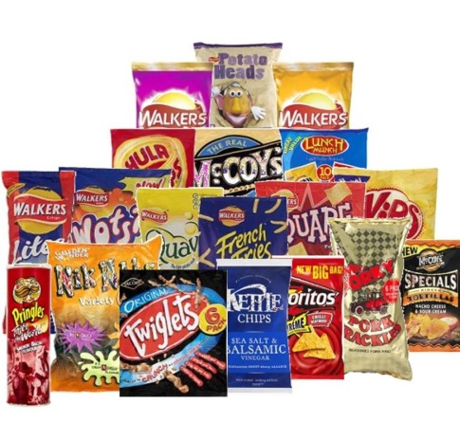
Television and eating patterns
Television viewing has been associated with:
Eating more often (Stroebele & Castro, 2004).
Eating more fast food (Taveras et al., 2006).
Snacking (Snoek et al., 2006; Thomson et al., 2006).
Eating more dietary fat (Epstein et al., 2005; Miller et al., 2008).
Lower intake of fruit and vegetables (Boynton-Jarrett et al., 2003).

Slide 18
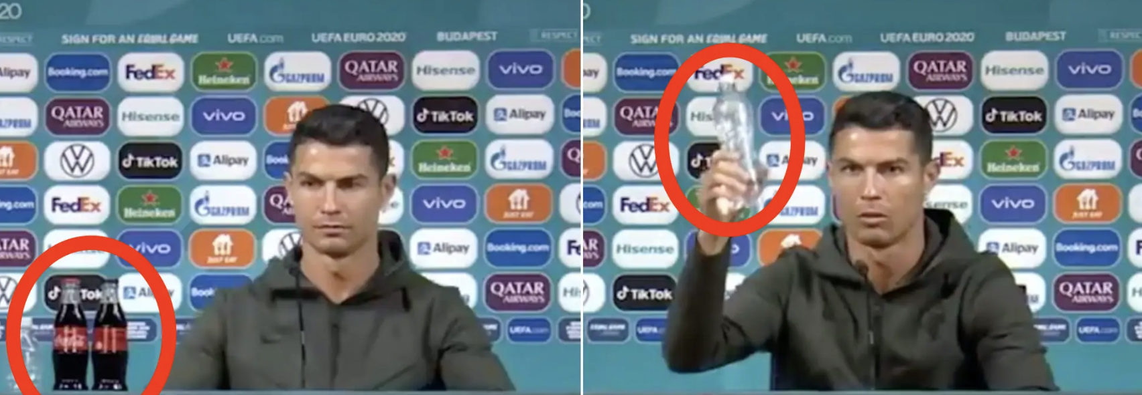
International Soccer Star Renaldo says “Drink Water Instead”

Slide 19
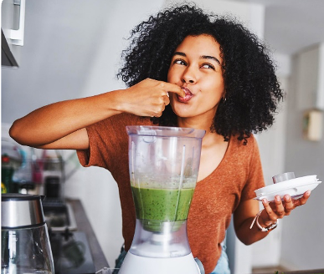
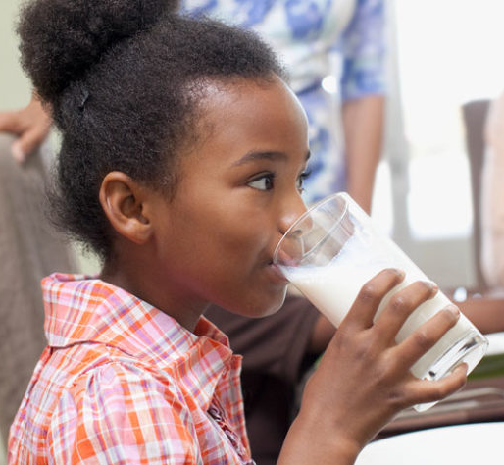
What should we drink?
Naturally occurring sugars, like in fruit and milk, are OK.
Green juice
High in nutritional value
Sweetened with fruits

Slide 20
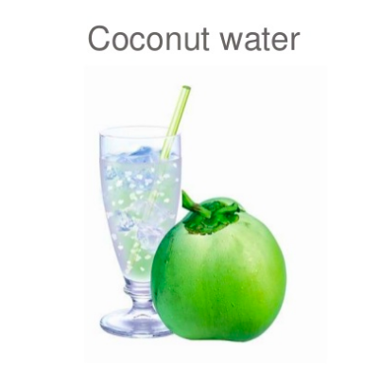
What should we drink?
Coconut Water
High nutrition value
Reduces high blood pressure
Plain water
To add flavour, try
¾ water, ¼ fruit
Gradually change your taste for sugar

Slide 21
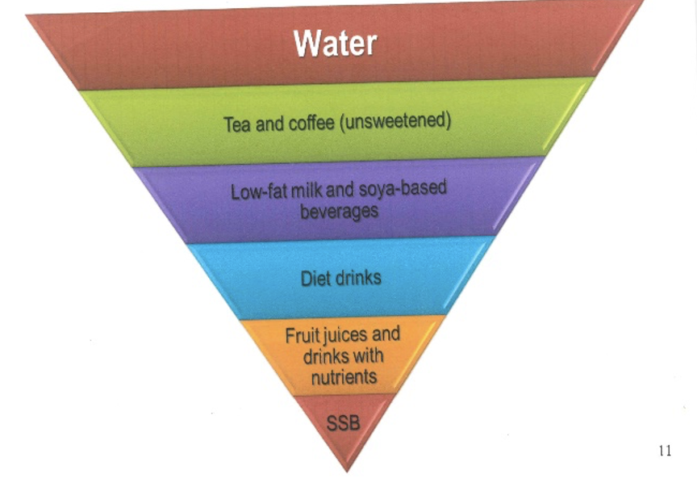
What should we drink?

Slide 22
Jamaica Government Policy
Ministry of Health and Wellness and Ministry of Education
Limit on sugar in drinks in schools 2019

Slide 23
MOHW HFJ Advocacy - Jamaica Media Campaign funded by Bloomberg Philanthropies
https://www.youtube.com/watch?v=t-WNCdIlWNY
https://www.youtube.com/watch?v=cQeeGB0i6VE

Slide 24
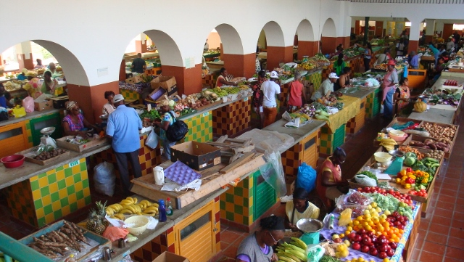

Slide 25
Our Partners
Improving Household Nutrition Security and Public Health in CARICOM

Slide 26
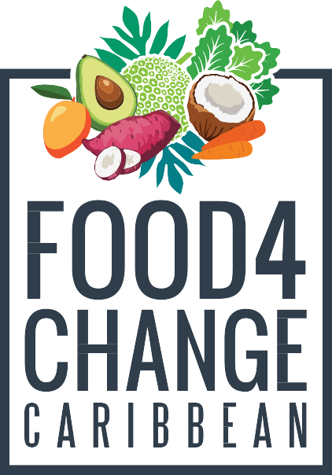
Thank you!
Improving Household Nutrition Security and Public Health in CARICOM
Prof. T. Alafia Samuels
Caribbean Institute for Health Research University of the West Indies, Mona
https://food4changecaribbean.org
@food4changecaribbean

